Slide 1
Automatic Challan Generation (Using AI)
By:
D. Naga Maheswari (16701A1218-AITSR)
K. Narasimhulu (16701A1219-AITSR)
C. B. Sujitha (16701A1237-AITSR)
S. V. P. Sruthi (16701A1241-AITSR)
(Hybrid-IT)

Slide 2
Contents
Introduction
Problem Statement and Solution
GUI Integration
Conclusion

Slide 3
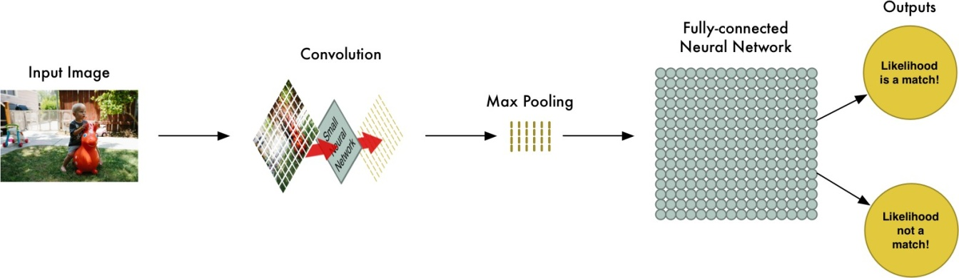
Convolutional Neural Network (CNN)
A convolutional neural network (CNN) is a specific type of artificial neural network that uses perceptions, a machine learning unit algorithm, for supervised learning, to analyze data.

Slide 4
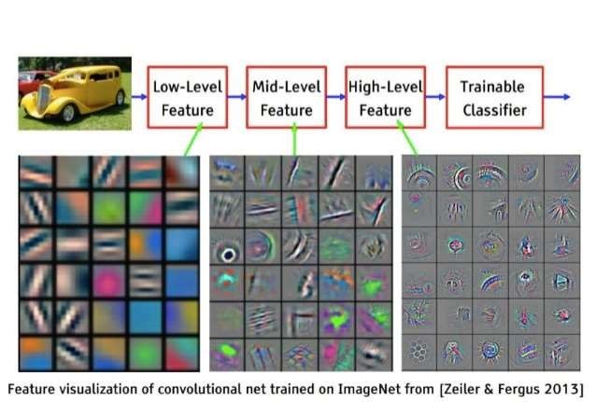
Convolutional Layer – Function
Extract features from the input image

Slide 5
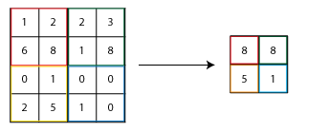
Pooling Layer – Function
Reduces the dimensionality of each feature map but retains the most important information

Slide 6
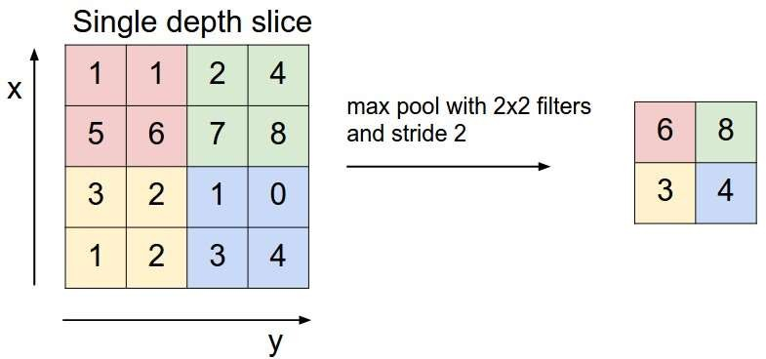
Pooling Layer – Max Pooling

Slide 7
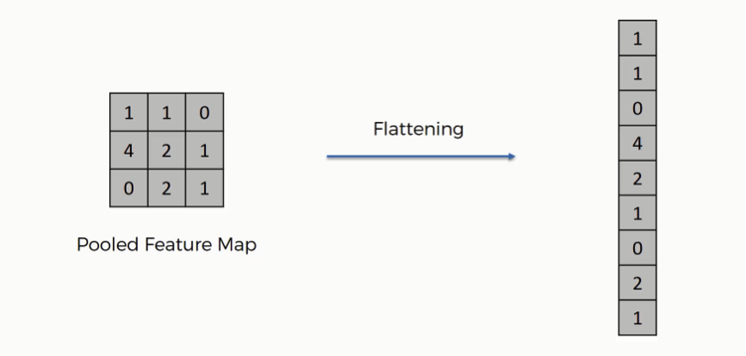
Flattening
Flattening is converting the data into a 1-dimensional array for inputting it to the next layer. We flatten the output of the convolutional layers to create a single long feature vector. And it is connected to the final classification model, which is called a fully-connected layer.

Slide 8
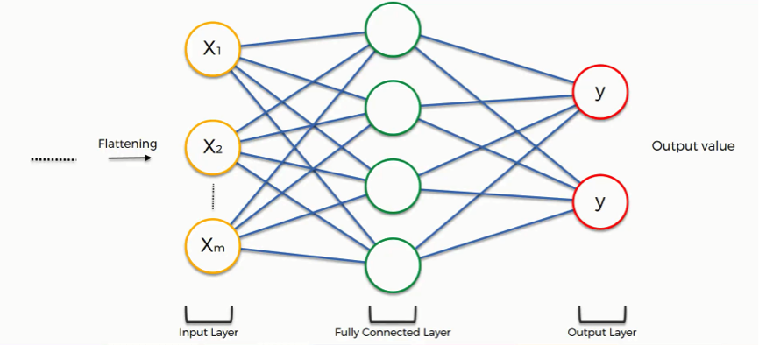
Full Connected
Here's where artificial neural networks and convolutional neural networks collide as we add the former to our latter. It's here that the process of creating a convolutional neural network begins to take a more complex and sophisticated turn.
As you see from the image below, we have three layers in the full connection step:
Input layer
Fully-connected layer
Output layer

Slide 9
Problem Statement
Automatic Challan Generation using CNN model for detecting if a person is wearing helmet or not.

Slide 10
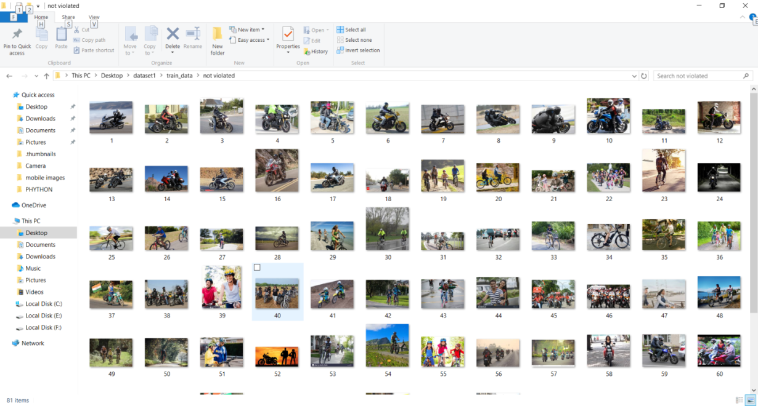
Data Collection
The data all we need here are images to train the model. We use CNN(convolution neural networks) model to develop a system which can predict if the person is wearing helmet or not. So for this we need images of persons wearing helmet and also not wearing helmet. We searched for datasets at different websites like https://www.kaggle.com/ and https://data.world/. We prepared dataset by downloading pictures from google .We downloaded almost 400 images and made a dateset with train and test data sets.

Slide 11
Step1:Convolution
The output of this step is featured map where the image is converted into a matrix form and featured map is the output of this particular layer. We used a sequential model and conv2D to break and convert given image into a matrix which gives featured map as output.

Slide 12
Step 2:Maxpolling
In maxpooling featured map is converted to pooled featured map by collecting major features from the image in other sense we can say eliminating background of the image . This process is done by taking maximum values or repetitive values from the featured map. The featured map is always of size 2x2.

Slide 13
Step3: Flattening
Although we use CNN model in the last we need to covert it to ANN model. By using CNN we convert images into inputs which are to be given to the ANN model. Here we create input and hidden and output layers using dense function . There can be n number of hidden layers which increases the accuracy of the prediction.
Step4:Full Connected
Here ANN model is used to predict the values by taking the given inputs. In we ANN have one input layer and n number of hidden layers. In ANN we have many iterations we can run n number of epochs which increases the accuracy of the model. The below figure illustrates the deep learning process that is used in cnn to analyze data and predict output.

Slide 14
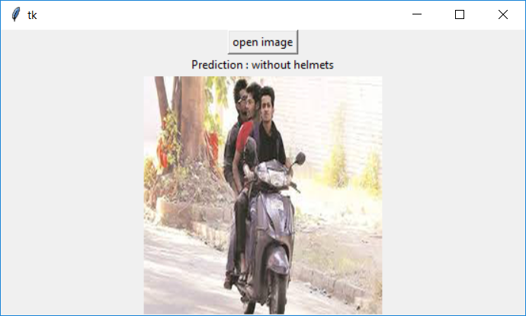
GUI
We used tkinter package from python to fetch the given image (as we giving input as image) and predict the output.

Slide 15
Conclusion
In this model we take a traffic picture as input and then using cnn model we predicted if particular vehicle violated rules by not wearing helmet. This model will be helpful in traffic management but it cameras must be automated to use this model and many developments must be done to improve the accuracy rate of this model. In future there may be chance of improvements in this model to make model more accurate.

Slide 16
Safety is gainful.
Accident is painful.

Slide 17
Thank You

